Slide 1



GROWING-UP INTERNATIONAL CORP.
GROWING-LEADER TRADING CO.,LTD.
GROWING-LINK DEVELOPMENT LTD.
No.31, 3 Alley, 75 Lane, Sec.2, Tai Ping Road, Tsao Tuen, Nantou, Taiwan
TEL: 886-49-2337927; e-FAX: 886-49-2337928
EMAIL: growing.leader@msa.hinet.net, growing-leader@umail.hinet.net
URL: http://www.growing8.com

Slide 2
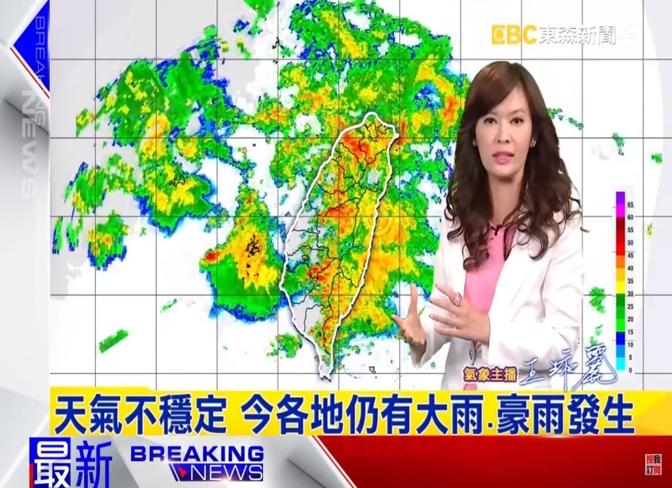
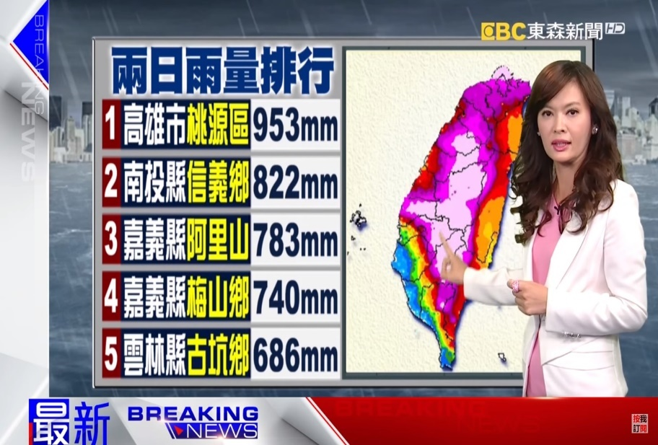
GPL-37 Chain Reaction Organic Fertilizer Story
The vineyard soaked in the rain water for 20 days
What happens next?
The demonstration vineyard in Changhua Big Village, Taiwan. The return report situation of rainstorm flooding in this rainy season (The raining since 06/02/2017 to 06/22/2017 for 20 days). Prevention is better than cure. Owners in this year after the grape trees germination, diluted GPL-37 chain reaction organic fertilizer 1: 1500, to irrigate at the root for 800 liters dosage, around 0.1 ha. Now encounter flood and the vineyard were soaked in rain water for 20 days, grape still is not softened, not cracked. It’s really useful.
Because the active ingredients of GPL-37 Chain Reaction Agent can promote pulp hypertrophy and the growth of epidermal cells at the same time so that it will not cause cracked-fruit or produce brown rot, dew disease, and so on. It's a crazy event.
Owner: Kang Vineyard
201706 edit by GROWING

Slide 3
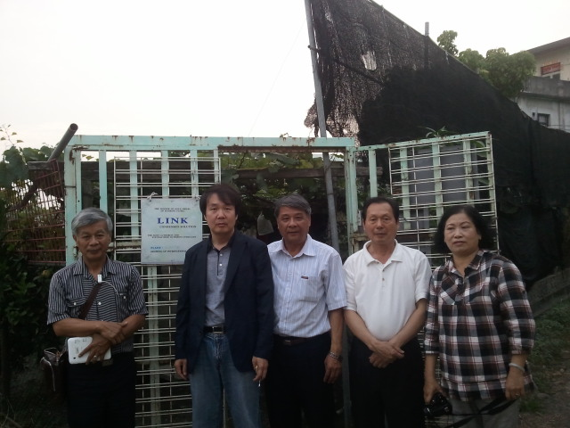

Korean Distributor Dr. T.K. Son visited at Kang Vineyard. 20121109 by GROWING

Slide 4
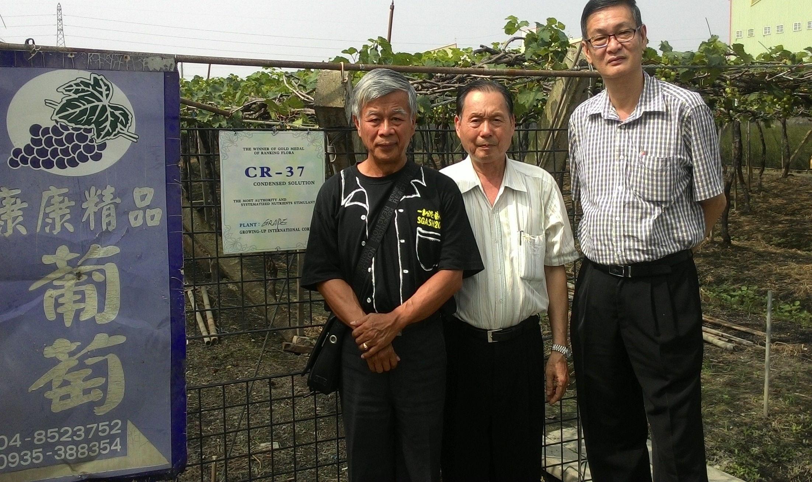
Indonesian Distributor Mr. David Hoo visited at Kang Vineyard.
20151027 by GROWING

Slide 5
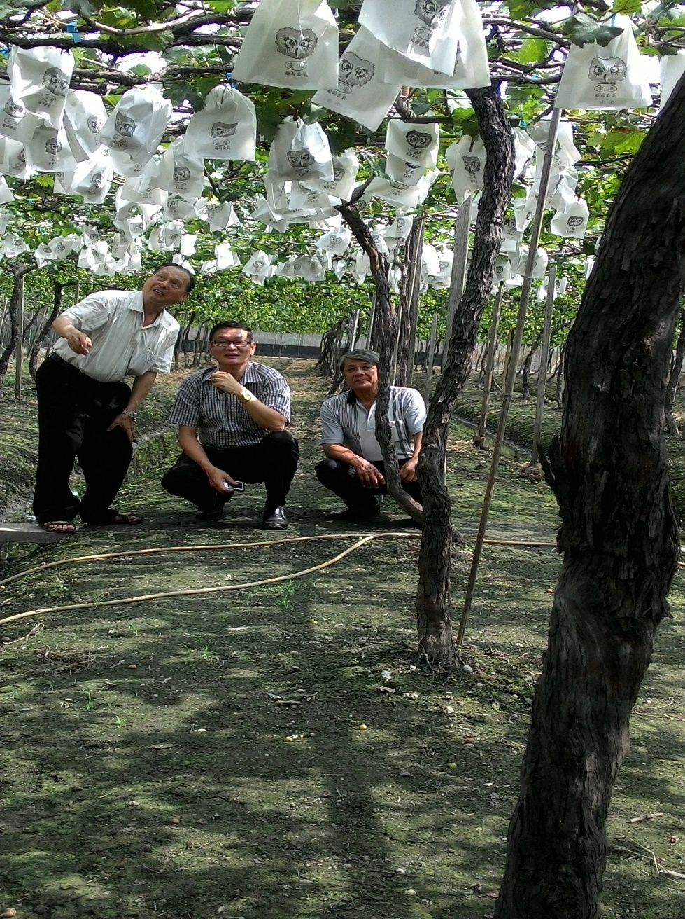
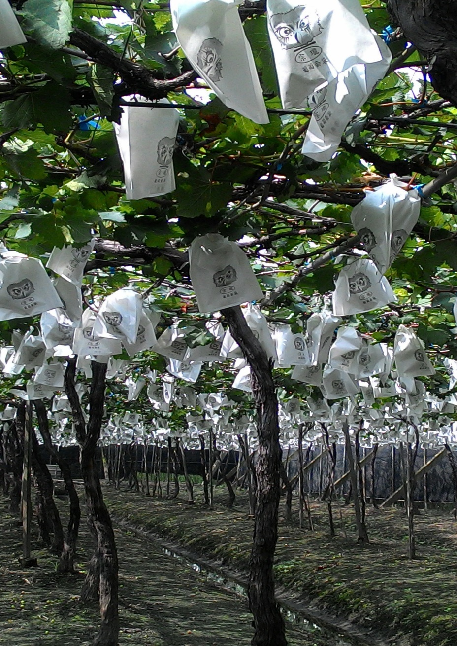
Indonesian Distributor Mr. David Hoo visited at Kang Vineyard. 20151027 by GROWING

Slide 6
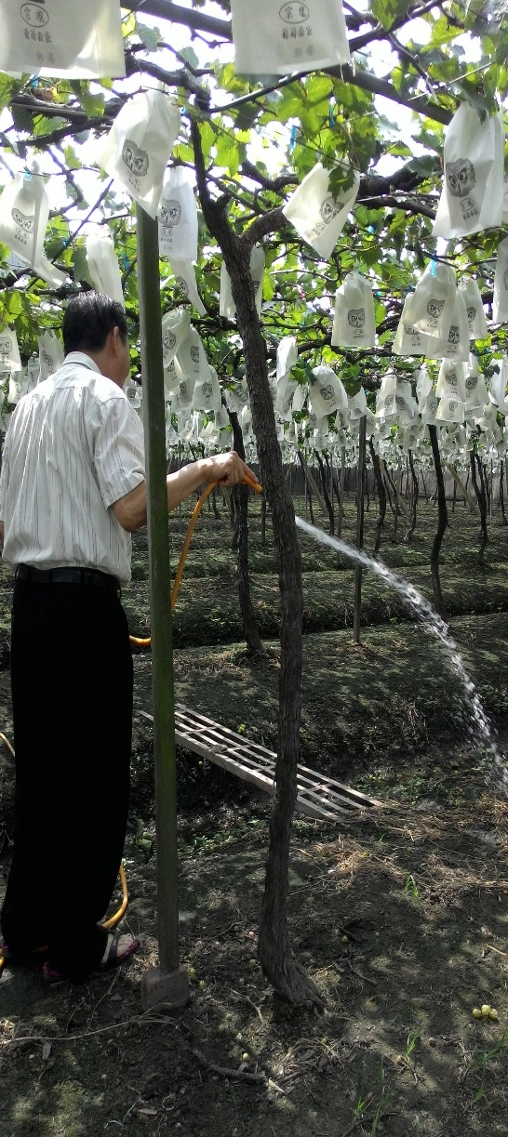
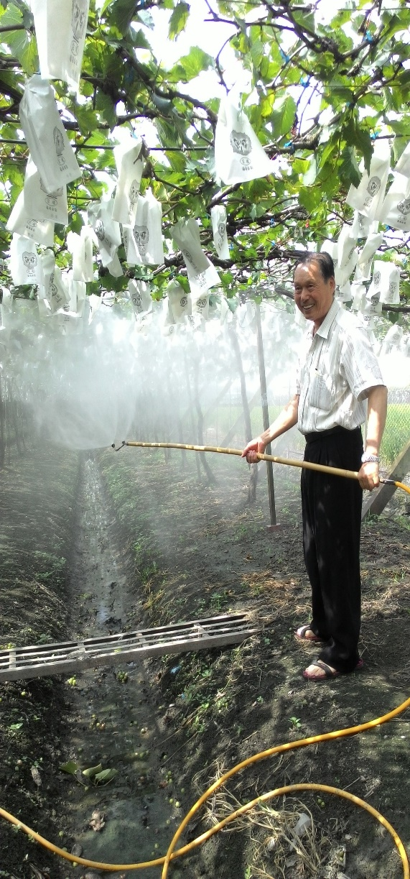
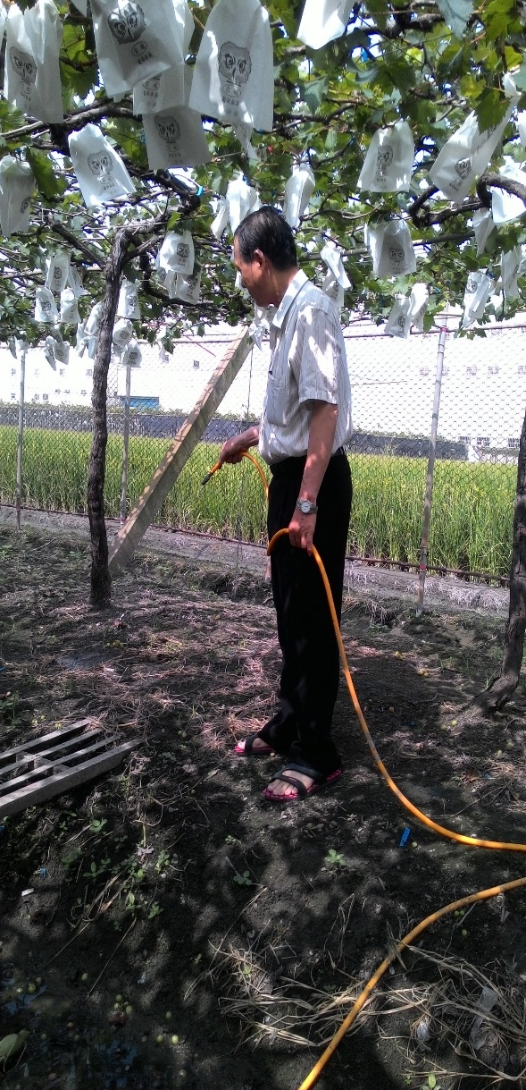
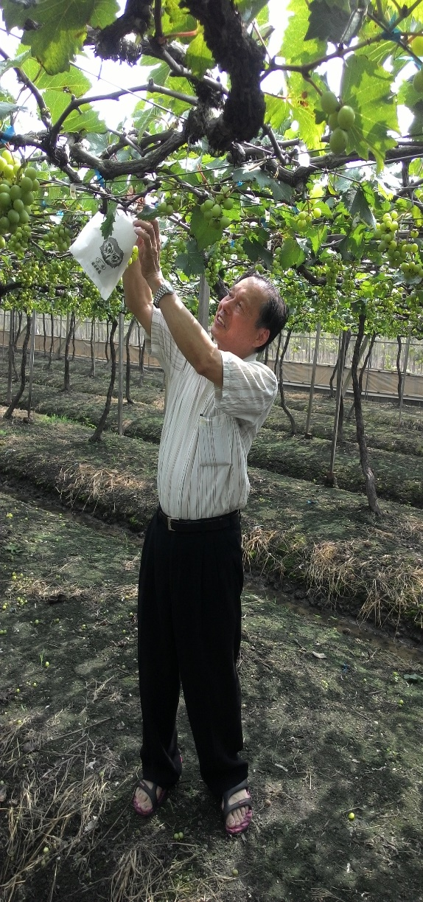
Kang Vineyard- Irrigation Owner Mr Kang.
20151027 by GROWING

Slide 7
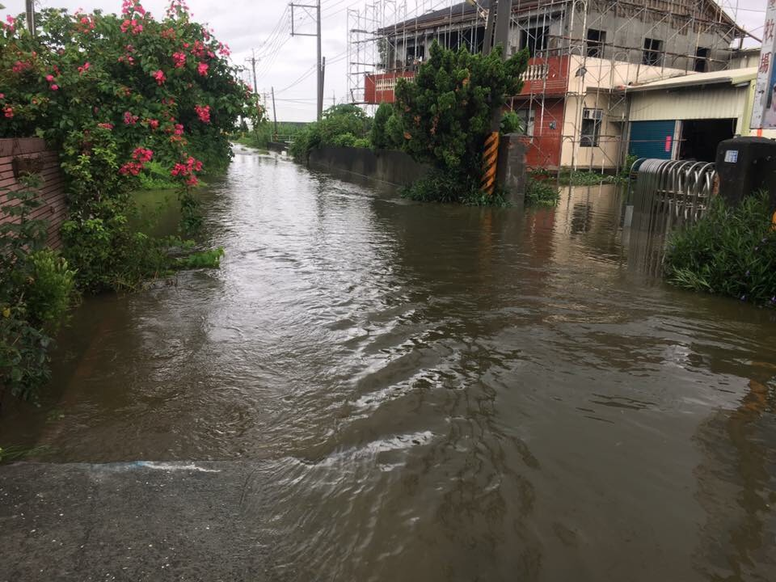
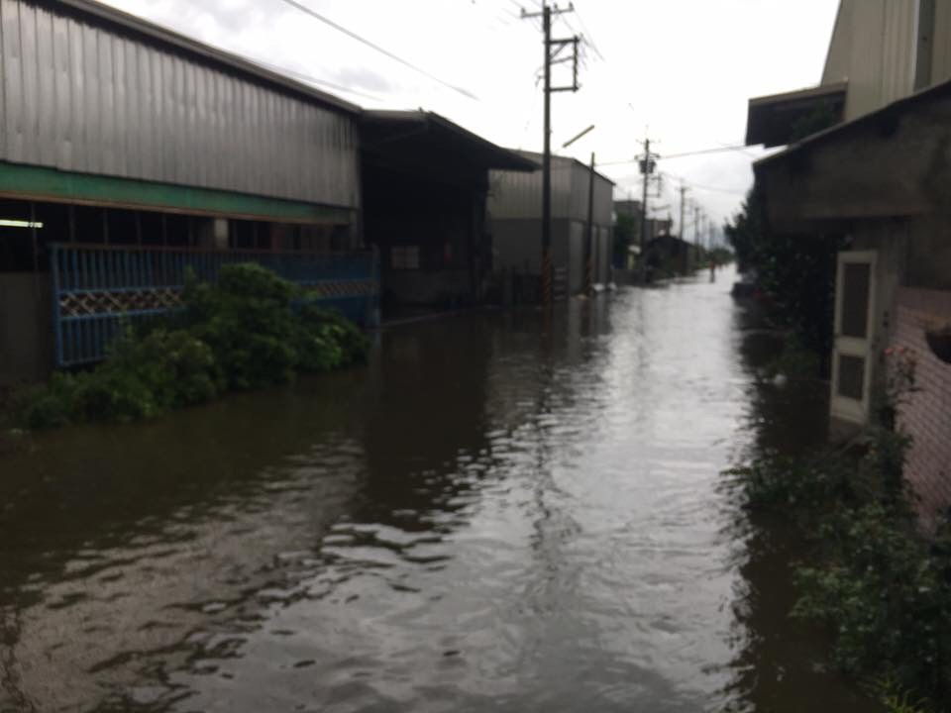
The terrible raining since 06/02/2017 to 06/22/2017 for 20 days.
201706 by GROWING

Slide 8
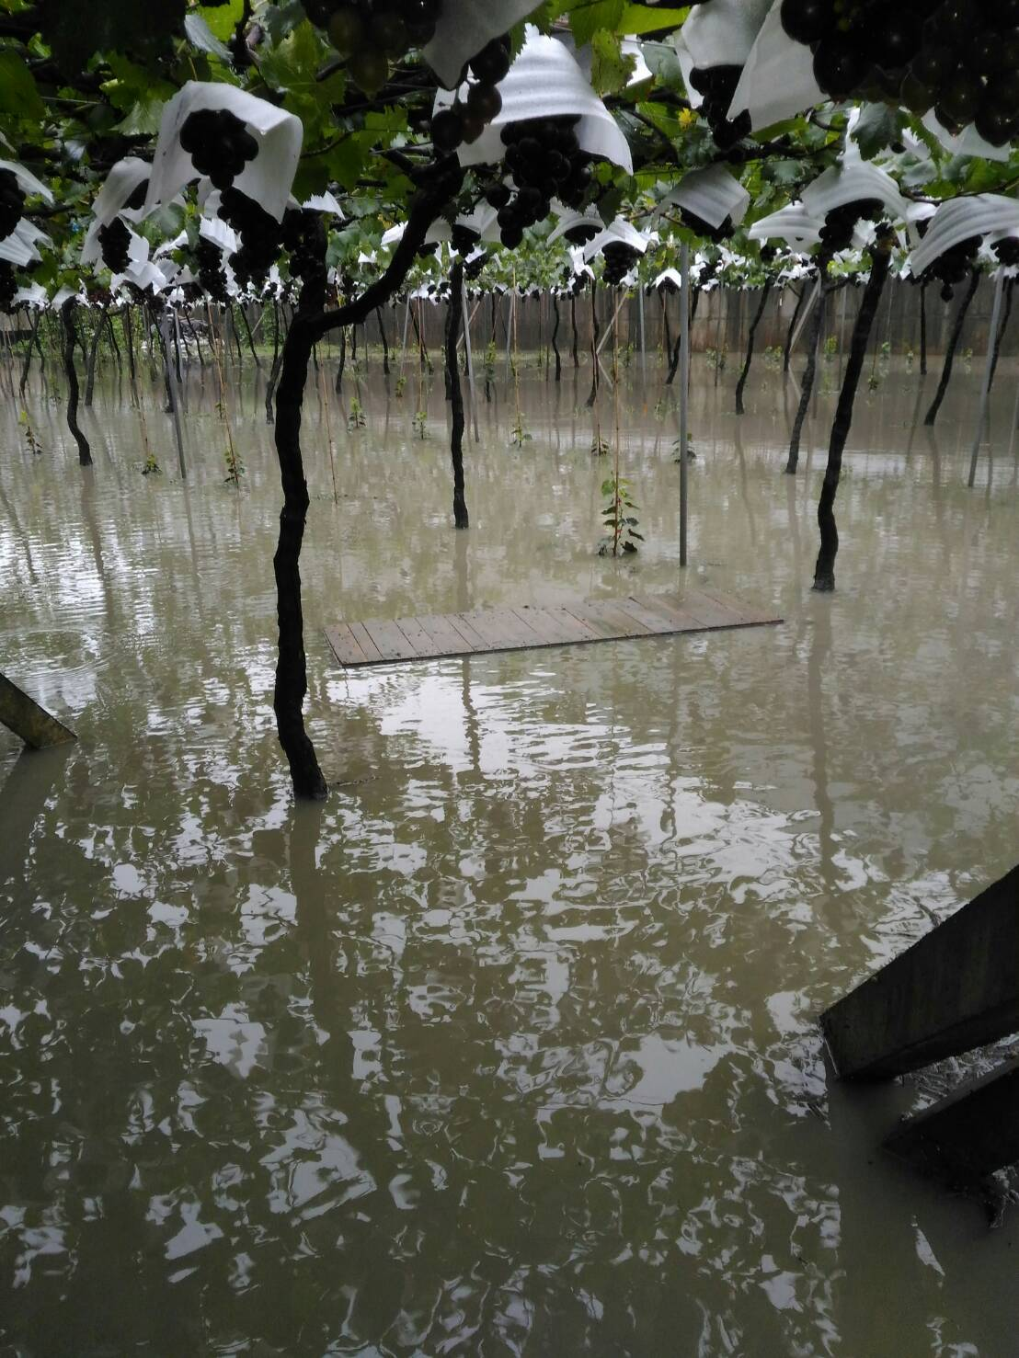
The demonstration vineyard in Changhua Big Village-encounter flood for 20 days.
Now is not soft-fruit, not cracked.
Its really useful.
201706 by GROWING

Slide 9
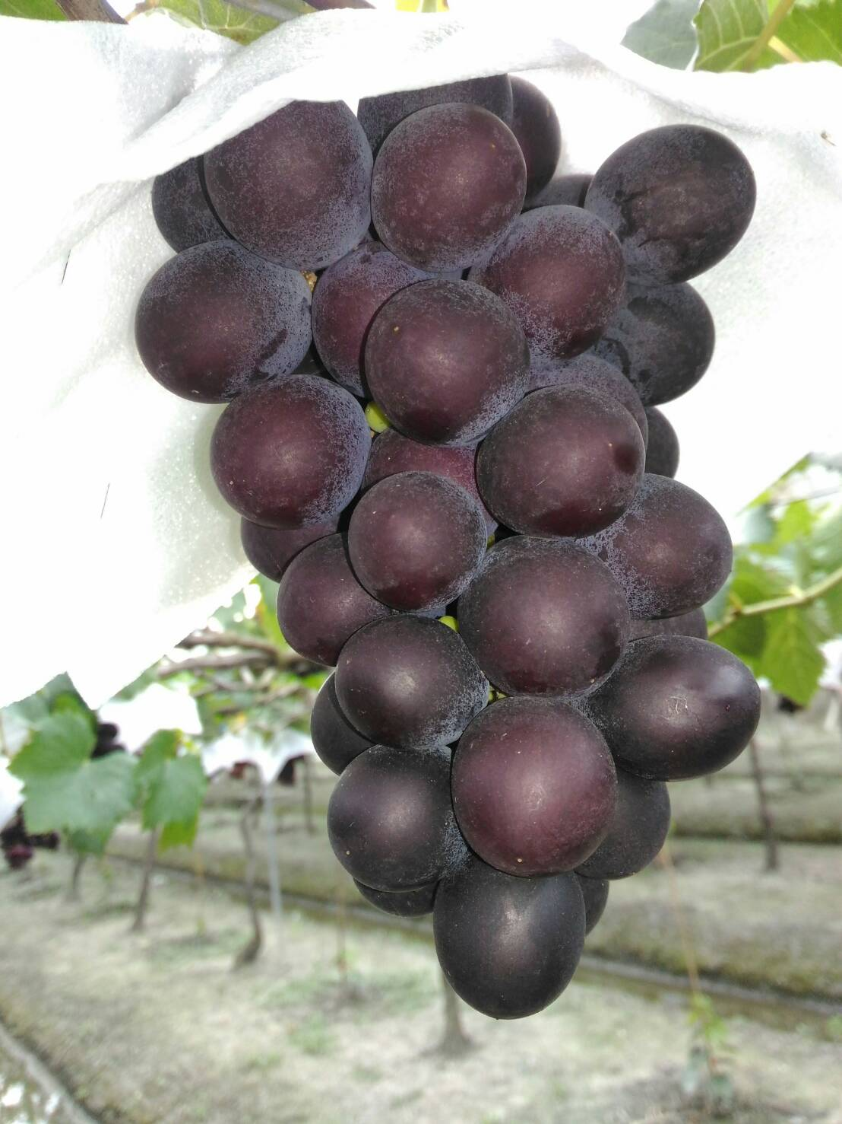
The demonstration vineyard in Changhua big village AFTER the flood 20 days.
Grapes very hard and tough, solid flesh plump.
201706 by GROWING

Slide 10
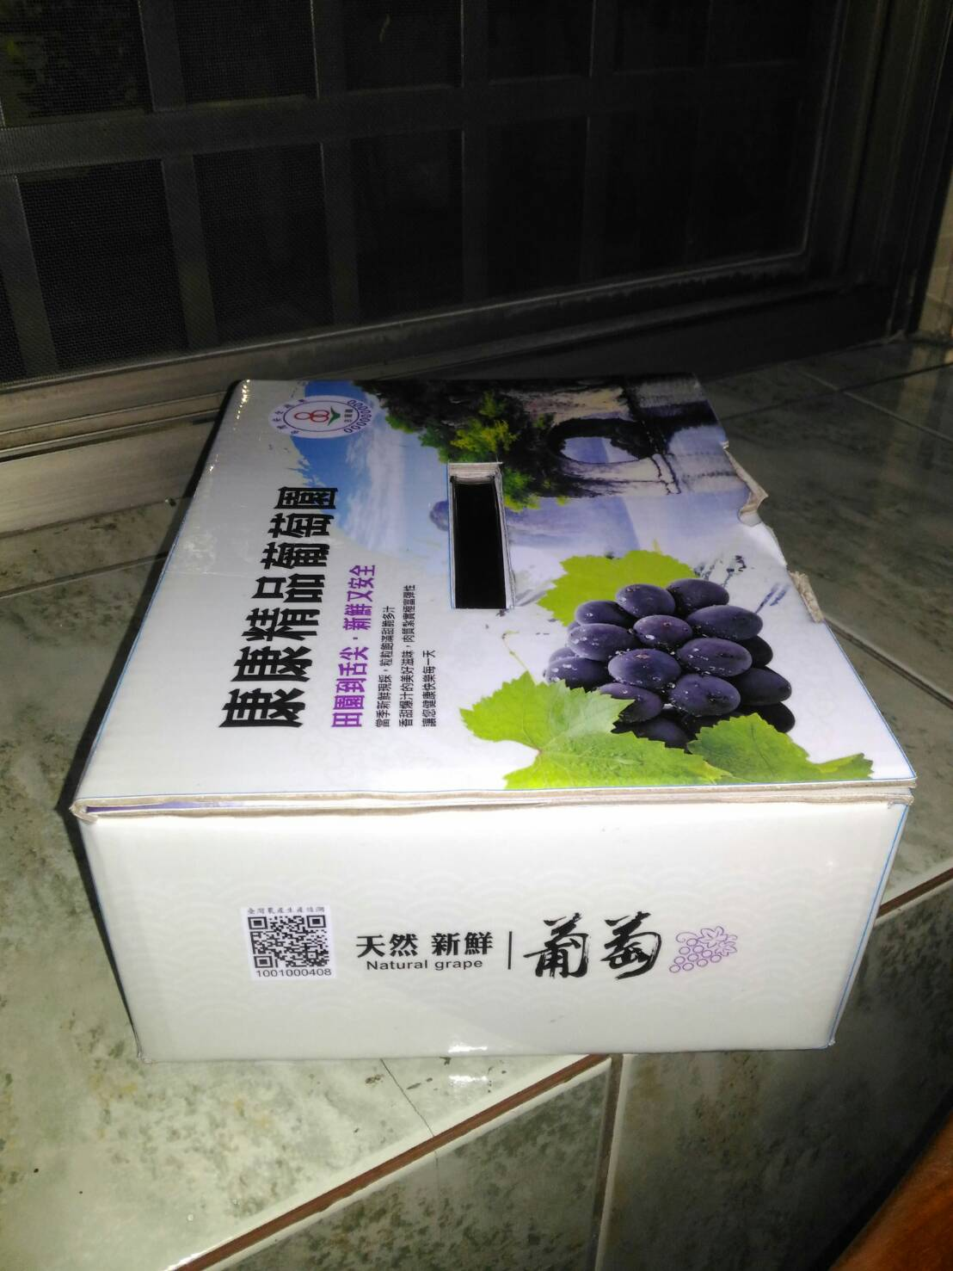
The demonstration vineyard in Changhua big village AFTER the flood 20 days.
Grapes very hard and tough, solid flesh plump.
201706 by GROWING

